Slide 1
Slidehood.com
MAKE A GAME
Ha Noi, 15/8/2019

Slide 2
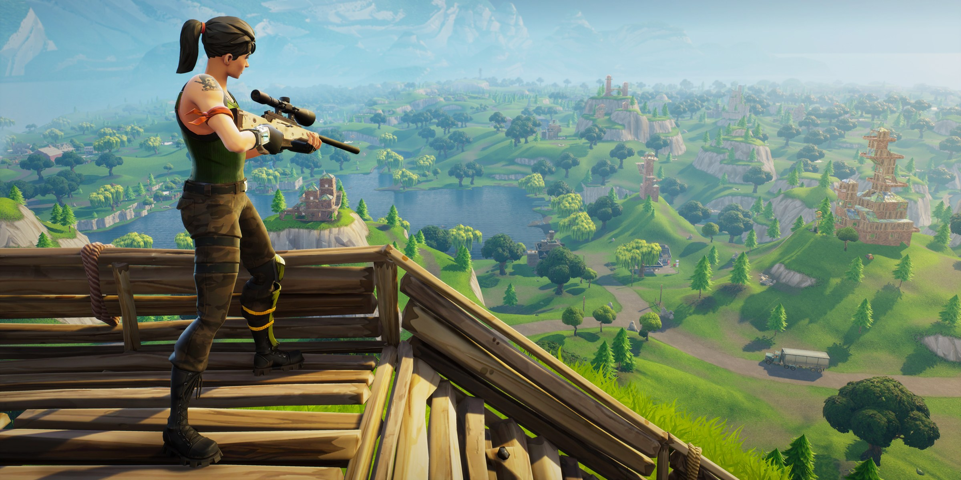



Make Game is easy
Slidehood.com
Things to know about make a game

Slide 3
My Process Is Simple
First Step
Learn to C++, Visual Srudio,…
Slidehood.com
Third Step
Code chi tiết, Đồ Họa, Giao Diện, Nhân Vật,…
Second Step
Giao vien Huong dan, Len Y tuong,...

Slide 4

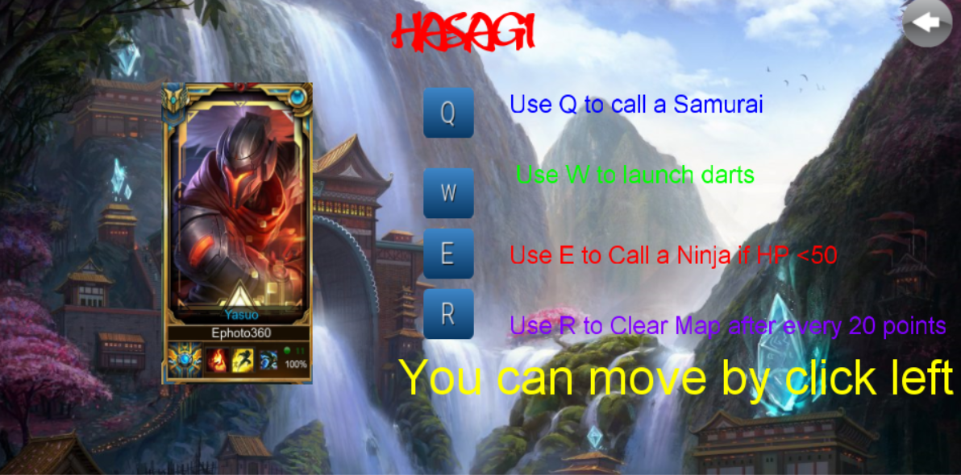
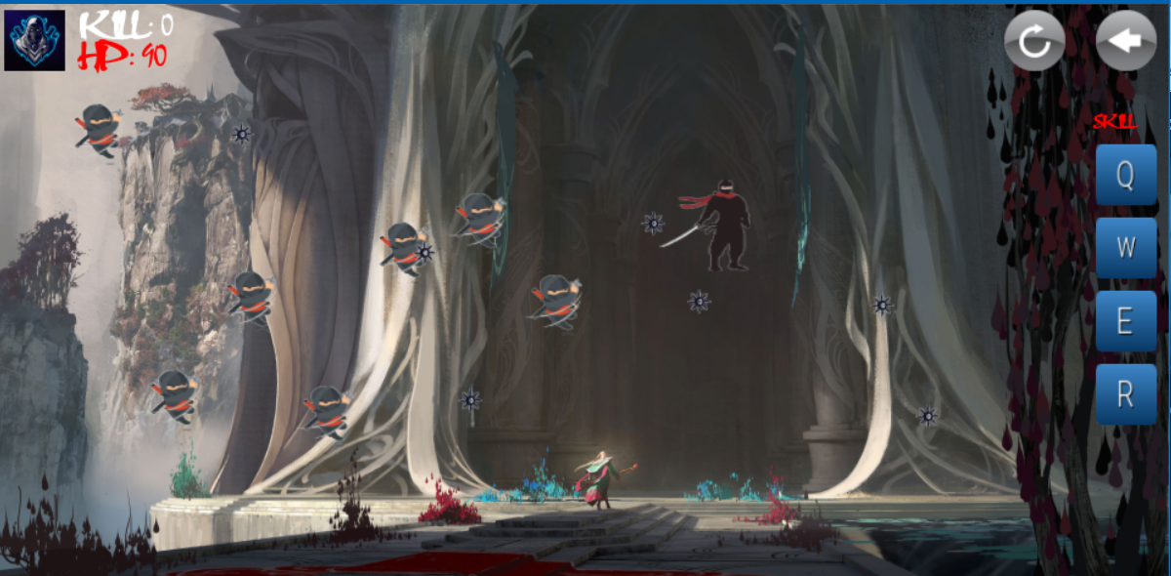

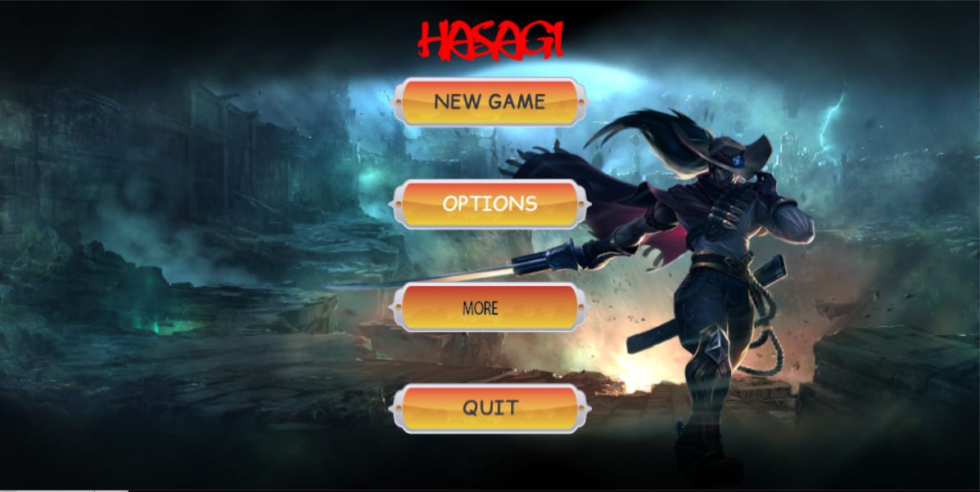
Slidehood.com
Big Idea
Grab the attention of your audience by using icons and impressive
images

Slide 5

Your Welcome Message Or Quote
Slidehood.com

Slide 6
Final result
Slidehood.com
Intership
We have a month
Nguyen Van Cuong
Teacher’s Helper
Gameloft
Place
A simple game
Make yourself my game

Slide 7

Thank You
Slidehood.com
Nguyen Thanh

